Slide 1
Predicting Hospital Readmission for Patients with Diabetes
By
P.B.N Rahul
T.V.S Ravi Teja
Iii B.Tech
Adikavi Nannaya University

Slide 2
Contents
Introduction
Aim of the Project
Tools and Requirements
Feature Engineering (Categorizing)
Training / Testing
Model Selection (or) Applying Algorithm
Deploying and generation of API
Developing of Web Application
Conclusion

Slide 3
Introduction
Diabetes is a disease that occurs when your blood glucose, also called blood sugar, is too high. Blood glucose is your main source of energy and comes from the food you eat.
Hospital Readmission Reduction Program (HRRP) is one of the crucial idea developed by CMS to improve the quality of care of patients.
This program aims to create a platform for looking after the high readmission fee charged to the patients while they are readmitting in the hospital .

Slide 4
Aim of the Project
The Final Goal of this project is to find out whether the patient with Diabetes will be readmitted to the hospital or not by using the reports after his first diagnosis (Data).

Slide 5
Tools and Requirements
Data Set is extracted from: https://archive.ics.uci.edu/ml/machine- learning-databases/00296/
Editor : Jupyter Notebook and IBM Watson Studio
Web Application : NoteRed

Slide 6
How to Approach It
Here we have taken different reports related for diabetes
And these reports are used for prediction of readmission as they decide the condition of the patients
We can eliminate some of the columns that are not used for prediction as follow

Slide 7
Feature Engineering
Dataset can be divided into 2 features :
Categorical Features : All the non integral data elements are under this feature eg :- race , gender
Extra Features : from the above dataset variable like age etc are under this feature

Slide 8
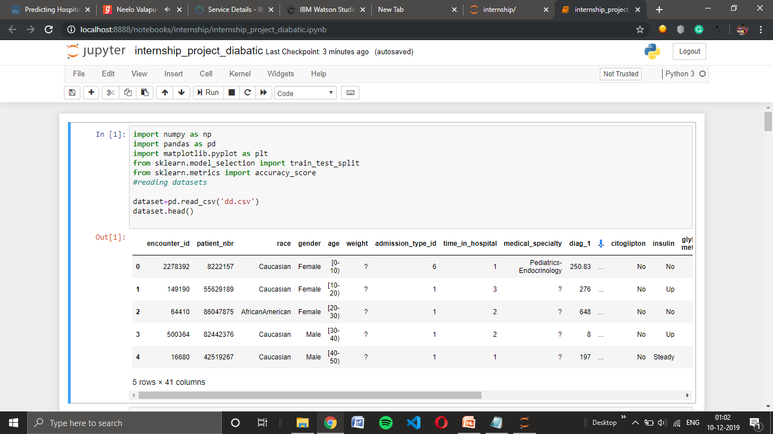
Importing the libraries used in the module

Slide 9
Label encoding
From the categorizing of the dataset by using Label Encoder
Categorical Features : 30
Extra Features : 1
X coordinates : Report results, age ,
medicinal specialty .
Y coordinates : Readmitted
The most occurring datasets are categorized uniquely and least occurrence are categorized into a single dataset

Slide 10
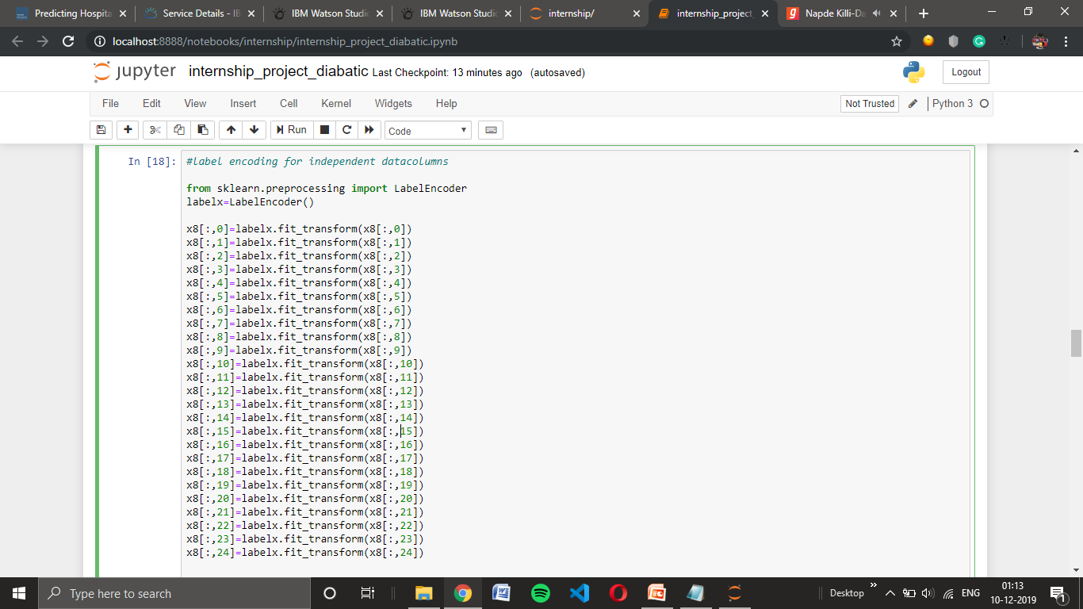
Categorizing feature encoding using Lable encoders

Slide 11
Training / Testing
Training : for given dataset “Training” is set to 80% to obtain maximum accurate result
Testing : for given dataset “Testing” is set to 20 % to verify with the prediction with random states value ‘0’

Slide 12
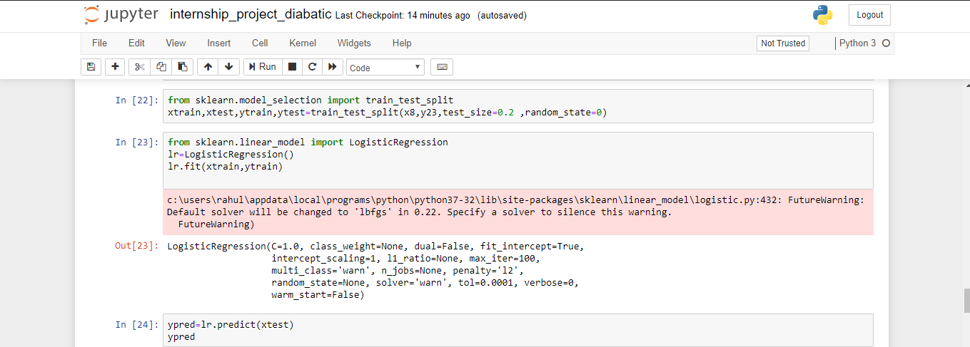
Spliting of data into Training ,Testing the data sets

Slide 13
Model Selection
For this project we used “classification” models for predictions of the hosipital readmissions based on reports.
As the output value depends on 2 factors “yes” or “no” it would be more likely to use classification models
We must have to select the model that has the highest accuracy among the models selected

Slide 14
Accuracy_score
Classification models accuracy can be calculated by using accuracy score.
The accuracy_score varies with different models:
Logistic Regression : 0.5422
k-nearest neighbour : 0.5484
Decision Trees : 0.5429
Random Forests : 0.5406
Naive Bayes : 0.5415
Support Vector Classifier : 0.5463

Slide 15
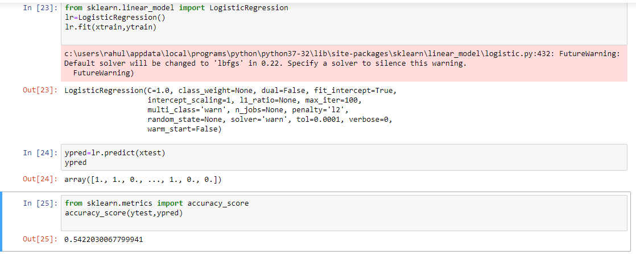
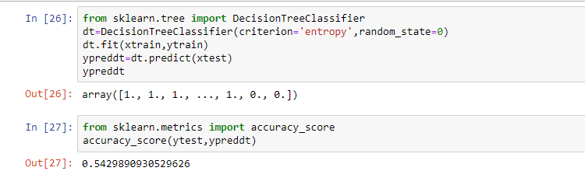
Logistic Regression
Decision Tree model

Slide 16
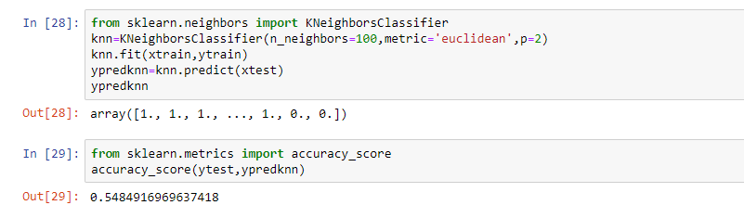
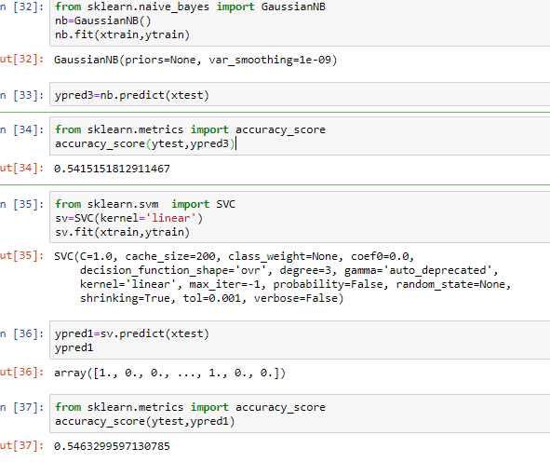
KNN model
Navie Bayes model &
SVC model

Slide 17
Continuation:
From the results obtained we can conclude that best efficient model for the operated dataset is K-Nearest Neighbour.
When compared to other models in knn model we are acquiring a high accuracy.
The prediction of readmission of patient is done by giving the reports as an inputs to the datasets

Slide 18
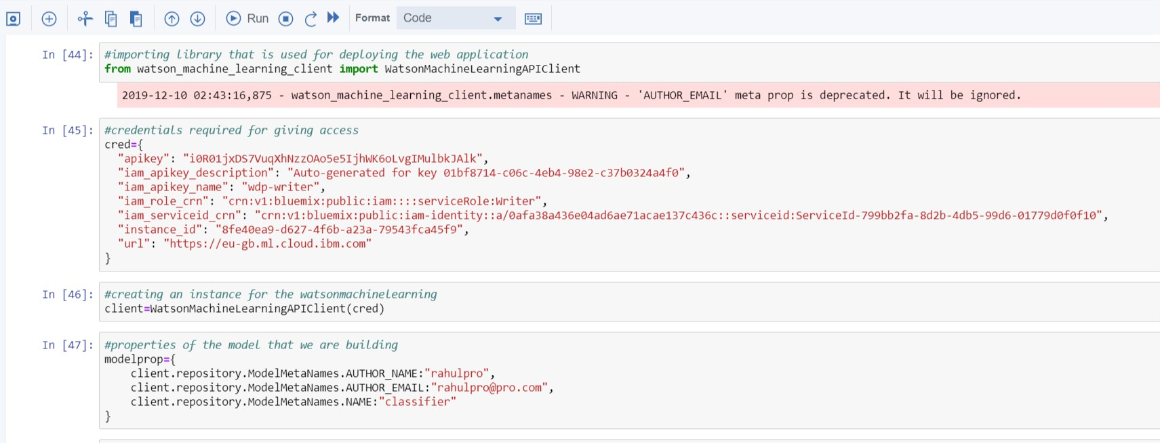
Deploying and Generation of API

Slide 19
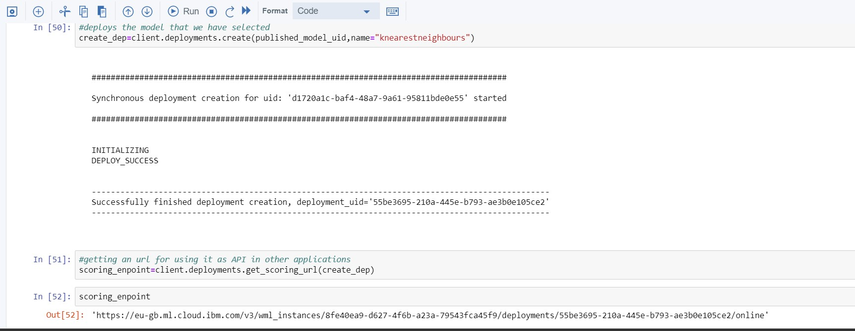
Continuation :

Slide 20
Conclusion
Through this project, we created a machine learning model that is able to predict the patients with diabetes with highest risk (categorical features) of being readmitted or not.
This project predictions are 56% are accurate.

Slide 21
Thank You

